Slide 1

Wifi: RAV-TRAINING
Password: Solve Challenges
http://xkcd.com/1597/
Hover text: If that doesn’t fix it, git.txt contains the phone number of a friend of mine who understands git. Just wait through a few minutes of “It’s really pretty simple, just think of branches as…” and eventually you’ll learn the commands that will fix everything.
Slides + Demo Code:
https://github.com/Kwen/sfdevs

Slide 2
Making Git Work For You
Kwen Peterson
Senior Software Developer @ Raven
kwen.peterson@gmail.com
@kwenarik

Slide 3
"You're already in the top tier of developers just by showing up here tonight. I don't know how talented you are, how much experience you have, but you showed up. You're putting yourself out there because you care to improve. Thanks for caring.“ – Scott Hanselman

Slide 4
Rebase vs. Merge
Merging brings two lines of development together while preserving the ancestry of each commit history.
In contrast, rebasing unifies the lines of development by re-writing changes from the source branch so that they appear as children of the destination branch – effectively pretending that those commits were written on top of the destination branch all along.
Rebase requires the commits on the source branch to be re-written, which changes their content and their SHAS.

Slide 5
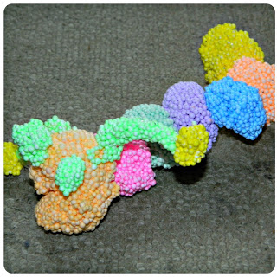

The merge DNA helix vs. rebase OCD

Slide 6
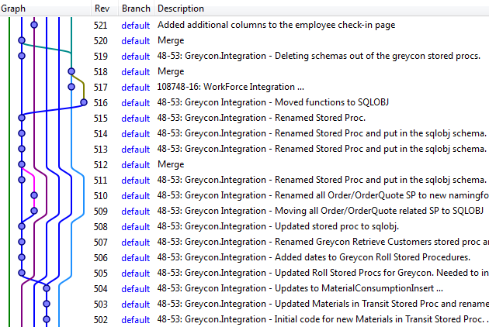
Commit graph (merge)

Slide 7
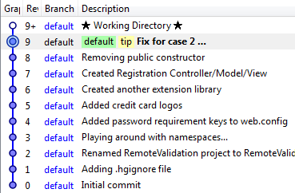
Commit graph (pure rebase with ff)

Slide 8
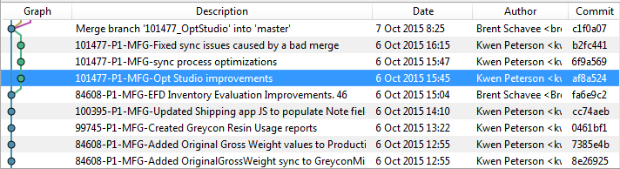
Ideal (no fast-forward)

Slide 9
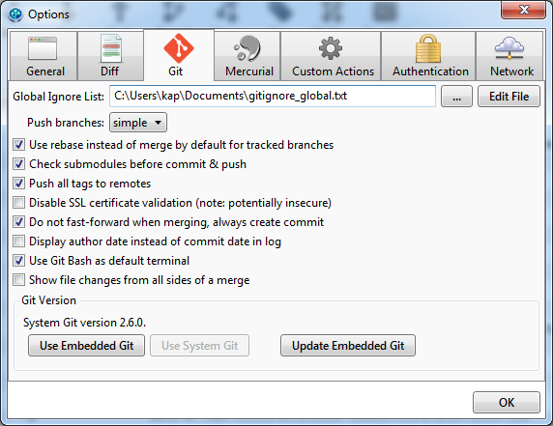
Git merge --no-ff <feature>

Slide 10
Merge
Pros
Simpler to use and understand
The commits on the source branch remain separate from other branch commits, provided you don’t perform a fast-forward merge. (This separation can be useful in the case of feature branches, where you might want to take a feature and merge it into another branch later.)
Existing commits on the source branch are unchanged and remain valid; it doesn’t matter if they’ve been shared.
Cons
If the need to merge arises simply because multiple people are working on the same branch in parallel, the merges don’t serve any useful historical purpose & create clutter.

Slide 11
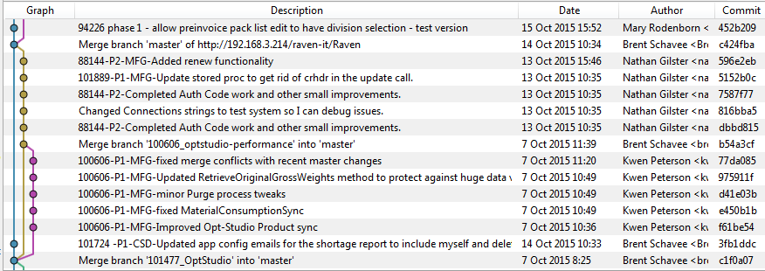
Master is the YELLOW commits

Slide 12
Rebase
Pros
Simplifies your history.
Is the most intuitive and clutter-free way to combine commits from multiple developers in a shared branch.
Cons
Slightly more complex, conflicts require resolution on a per commit basis.
Rewriting of history has ramifications if you’ve previously pushed those commits elsewhere.

Slide 13
Why does my boss/team care?
Merging
Merge conflicts between your changes and others doesn’t happen until you merge back into master and resolve them there, with new commits that happen after the merge commit.
You are testing your changes in isolation until you merge with master
Rebasing
Merge conflicts between your changes and others happens in your feature branch and are resolved in your feature branch.
You are testing your changes with the latest changes from master in your topic branch.

Slide 14
When should I rebase?
Fine fine fine. You’ve convinced me to try out this “rebase” thing. How often / when should I rebase changes from master into my feature branch?
Every morning? Wait until I have my feature branch working in isolation and then do one monster rebase resolving 2 months worth of differences?
“It depends.” ☺
In my 6.5 years of experience with git, it seems to amount to the same time/effort either way. You either pay for it in smaller ~10 minute chunks, or in one massive, 2 hour long rebase session at the end.

Slide 15

Let’s talk about merge conflicts…

Slide 16
Merge Conflicts!
Git rebase origin/master
Hit a conflict → git mergetool
Ok, everything’s fixed → git rebase --continue
(loop)
Crap! I messed that up and need to bail out! → git rebase --abort
Hmm, looks like I made the exact same change in my topic branch as was already made in master, I need to skip this commit and keep rebasing → git rebase --skip
If you have issues with a merge and want to revert it while the merge is in progress, the equivalent is git reset HEAD --hard.
Remember, rebase applies commits one at a time and makes you deal with any conflicts one at a time. Merge simply looks at the <initial state> vs. <cumulative end state> and gives you a single, massive set of changes to resolve!

Slide 17
Merge Conflicts
git merge <branch> (git merge feature-47_fixed-stuff)
Merge changes in the specified branch onto the current branch
In a merge conflict branch you are ON is local, branch specified in the merge is remote.
git rebase <remote>/<branch> (git rebase origin/master)
Base the current branch you are on off the specified remote branch
Takes the specified branch as the base, and then applies any changes you have in your local branch on top of that. For conflicts, the current branch is called remote, and the branch you specified is treated as local.
Assuming you are merging feature branches into master or rebase feature branches with master, local = master, remote = feature in both situations.

Slide 18
Interactive Rebase (Squash)
git rebase –i HEAD~3
pick f392171 Added new feature X
pick ba9dd9a Added new elements to page design
pick df71a27 Updated CSS for new elements
Change to:
pick f392171 Added new feature X
squash ba9dd9a Added new elements to page design
squash df71a27 Updated CSS for new elements

Slide 19
Squash Demo

Slide 20
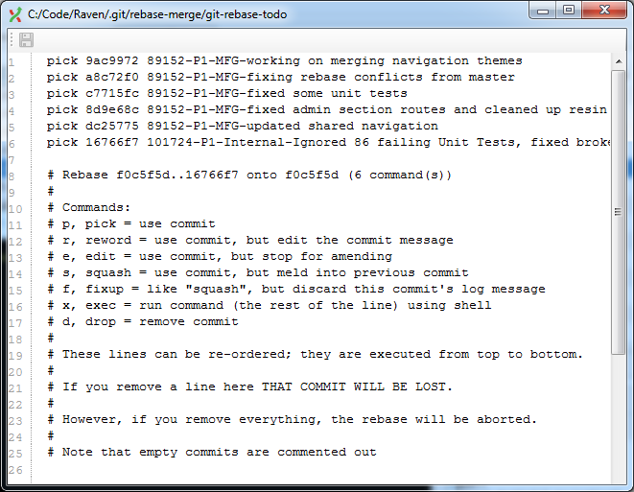

Slide 21
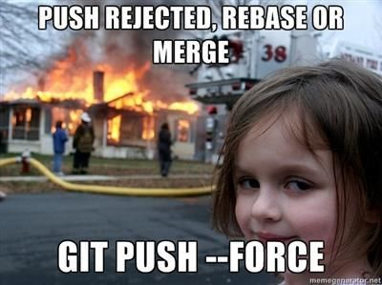
(Or git push –f origin master Or git push origin +master:master)
Golden Rule of Rebasing: NEVER EVER* rebase a branch that you already pushed or that you pulled from another person.
* Except for when you truly want/need to rewrite the history of your repository.

Slide 22
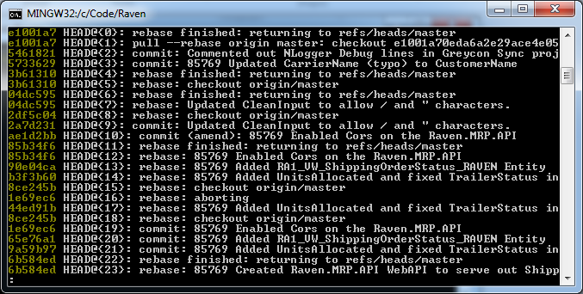
git reflog
Uses VIM navigation controls: J = down arrow, K = up arrow, Q = quit
Use the commit hashes, not the HEAD positions! To go back in time and return your current branch to a prior state, the syntax is git reset 2a7d231 --hard. (This will return you to the point before the last 2 rebases in the above screenshot.)

Slide 23
Reflog demo

Slide 24
Detached Heads, Submodules
Detached Head – Tracking a specific commit, not a branch!
If git was a book:
HEAD is where your finger is (current spot)
Branches are where you put your bookmarks
If you close the book without a bookmark on that page, you lose your spot!
Submodules – Shared ‘child’ git repository (notorious for detached HEAD issues…)

Slide 25
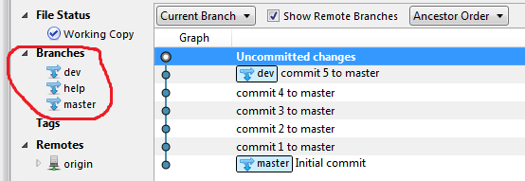
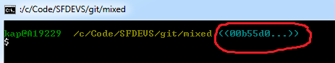
What does a detached head look like?
Notes:
Demo

Slide 26
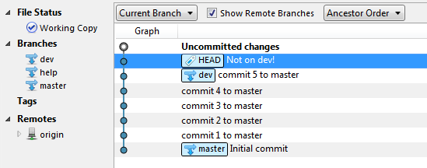


Slide 27
Mixed Demo

Slide 28
git worktree (new in 2.5.0)
Who here has a co-worker that instead of swapping branches just pulls down multiple copies of the repo into different folders?
Allows you to checkout multiple branches simultaneously (master + sprint/feature)
Instead of stash, you can you this!
git worktree add -b hotfix ../hotfix origin/master
After work/commits are done, simply delete the /hotfix folder!
All worktree branches use the “parents” .git repo
Saves space, all worktree branches are dumb/disposable

Slide 29
Code Review Demo
Notes:
Demo with code review: git worktree add –b codereview ../Raven-codereview origin/100805-MFG-ATD-Kanban_SortKbRelease

Slide 30
2nd Order Diff Trick
Migrating Textile URLs to Markdown using Regex
s{"(.+?)":([^.,:\s]+)}{[$1]($2)}g ← Not even close
s{"(.+?)":([^.,!\)\]\s]+)}{[$1]($2)}g ← Not even close
s{"(.+?)":([^,!\)\]\s]+)\b}{[$1]($2)}g ← Getting closer
s{"(.+?)":([^,!\)\]\s]+)}{[$1]($2)}g ← Pretty close!
git stash save “almost there”
s{"(.+?)":([^,!\)\]\s]+)}{my($t,$l)=($1,$2);$l=~/(.*?)([.:])?$/; "[$t]($1)$2"}eg ← “minor tweak”
git diff ‘stash@{0}’
http://blog.moertel.com/posts/2013-02-18-git-second-order-diff.html

Slide 31
Filter Branch
git filter-branch --force --index-filter 'git rm --cached -r --ignore-unmatch MY-BIG-DIRECTORY-OR-FILE' --prune-empty --tag-name-filter cat -- --all
This is SLOW.
You have to use the full path to the file/folder you want filtered out.
You would have to run it twice for /bin/OpenId.dll & /bin/debug/OpenId.dll (or generate a file with all the path/filenames, then script it against the above.)

Slide 32
BFG Repo Cleaner
Written in Scala, requires JVM 7+
Much faster (10-720x faster)
Much easier to use (alias java -jar bfg.jar to bfg)
bfg --delete-files EntityFramework.dll my-repo.git
Purge EntityFramework.dll out of the 105 bin folders in my solution in one easy, readable command.
bfg --strip-blobs-bigger-than 10M my-repo.git
Purges any file from history that was ever larger than 10Mb
bfg --delete-files id_{dsa,rsa} my-repo.git
Purges id_rsa & id_dsa files from any path and point in time
bfg --delete-folders bin my-repo.git
Notes:
Demo

Slide 33
Raven.git Demo
Notes:
java -jar /c/python27/bfg-1.12.7.jar --delete-files Quartz.dll /c/Code/Raven.git/

Slide 34
BFG
git clone --mirror <old_remote>
bfg –delete-files Quartz.dll my-repo.git
<repeat>, inspect your changes. If happy proceed!
git gc
cd my-repo.git
git reflog expire --expire=now --all && git gc --prune=now –aggressive
git push <new_remote>

Slide 35

Git LFS

Slide 36
Git LFS Cheatsheet
Install the commandline git extension, then run git lfs install or git lfs init
git lfs track “*.psd”
Only works going forward, you will have to use BFG or filter branch to retroactively purge any already committed large files!
git-lfs fetch (get me the ACTUAL huge files)
git-lfs push
git-lfs status (status on just the LFS tracked files)
bfg --convert-to-git-lfs '*.psd' --no-blob-protection

Slide 37
Migrate from SVN
git svn clone http://svn.example.com/project/trunk
Git svn fetch, git svn rebase
Git svn dcommit
Have a non-standard directory layout?
https://git-scm.com/docs/git-svn

Slide 38
Migrate from Mercurial (hg)
Hg fast-export plugin (seems to be the most popular currently)
hggit Mercurial plugin
git-hg git plugin
gitifyhg git plugin

Slide 39
Resources
Cheat sheets
https://training.github.com/kit/downloads/github-git-cheat-sheet.pdf
http://www.git-tower.com/blog/git-cheat-sheet/
https://www.atlassian.com/dms/wac/images/landing/git/atlassian_git_cheatsheet.pdf
http://ndpsoftware.com/git-cheatsheet.html
Recommended
http://rogerdudler.github.io/git-guide/
http://www.slideshare.net/lemiorhan/git-branching-model?utm_source=slideshow&utm_medium=ssemail&utm_campaign=weekly_digest
GitFlow: https://www.atlassian.com/git/tutorials/comparing-workflows/gitflow-workflow
Worktree: https://github.com/blog/2042-git-2-5-including-multiple-worktrees-and-triangular-workflows
Submodules: https://git-scm.com/book/en/v2/Git-Tools-Submodules
Git Clients
http://sourcetreeapp.com/ (Mac/Windows GUI)
http://gitextensions.github.io/ (Windows)
https://github.com/dahlbyk/posh-git (PowerShell command line)
http://www.git-tower.com/ (Mac client)

Slide 40
Resources II
Git LFS
https://git-lfs.github.com/
http://www.sitepoint.com/versioning-large-files-with-git-lfs/
https://help.github.com/articles/installing-git-large-file-storage/
https://help.github.com/articles/about-git-large-file-storage/
https://help.github.com/articles/configuring-git-large-file-storage/
https://github.com/blog/1986-announcing-git-large-file-storage-lfs
https://about.gitlab.com/2015/11/23/announcing-git-lfs-support-in-gitlab/
http://stackoverflow.com/questions/33330771/git-lfs-this-exceeds-githubs-file-size-limit-of-100-00-mb
BFG
https://help.github.com/articles/remove-sensitive-data/
https://rtyley.github.io/bfg-repo-cleaner/
http://blog.ctp.com/2014/04/15/cleaning-up-git-repositories-with-the-bfg-repo-cleaner/
Git LFS support: https://github.com/rtyley/bfg-repo-cleaner/releases/tag/v1.12.5
Filter Branch
Filter branch stuff: https://multiplestates.wordpress.com/2015/03/04/reducing-the-size-of-a-git-repository-by-removing-a-file-or-folder-from-its-history/

Slide 41
Kwen Peterson
@kwenarik
kwen.peterson@gmail.com
https://github.com/Kwen/sfdevs
These slides + Demo Examples

Slide 42
Common git branching strategy
3 core branches: master, dev, release
Master is “the truth” and should always be in a stable, fully-functional state. This is where new topic/feature branches are cloned from. (nightly builds)
Dev is where integration testing happens. This is where topic branches are pushed and tested PRIOR to being signed off on as stable enough to go to master. (continuous integration, test environment)
Release is where the last live build lives. This exists so that if an absolutely critical issue arises, we can make the fix here and release the build, being confident that the ONLY change going out is the critical bug fix.

Slide 43
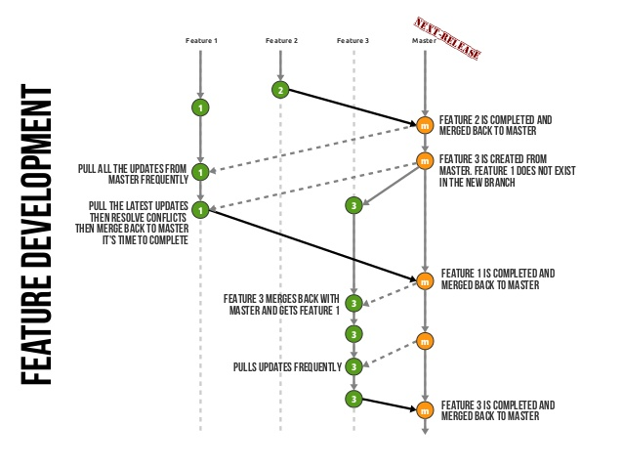

Slide 44
